Slide 1
V i r o l o g y -
an overview

Slide 2
Who am I?
Ronald C Desrosiers
Professor of Pathology
University of Miami Miller School of Medicne
Research
  Strategies of AIDS Virus Replication and Persistence
  Strategies of Herpesvirus Replication and Persistence
  Vaccine development for AIDS
What am I doing here?

Slide 3
Question
Which of the following is an important factor for the classification of a virus within the 22 families of mammalian viruses?
  nature of the disease that it causes
  whether RNA or DNA is the genetic material
  size of the viral-encoded envelope protein
  all of the above
  none of the above

Slide 4
Microbiology - the study of microscopic organisms and non-living infectious agents
Bacteria
- living (i.e. autonomously replicating)
- prokaryotic (i.e. lack nuclei)
- examples: E. coli; strep throat
Eucayotic microbes
- fungi (athlete’s foot) - algae
- protozoa (malaria) - parasites
Viruses
non-living in that they depend on the host cell
to replicate themselves

Slide 5
Flow of genetic information
Cells
DNA → RNA → Protein
Viruses
DNA → RNA → Protein
RNA → RNA → Protein
RNA → DNA → RNA → Protein

Slide 6
Families of Viruses
DNA RNA RNA
Adenoviruses Reoviruses Retroviruses
Papovaviruses Picornaviruses Bunyaviruses
Papillomaviruses Arenaviruses Filoviruses
Parvoviruses Togaviruses Coronaviruses
Herpesviruses Calciviruses Astroviruses
Poxviruses Flaviviruses Bornaviruses
Hepadnaviruses Orthomyxo Rhabdoviruses
Paramyxo

Slide 7
Fields Virology, 6th Ed [PDF][tahir99] VRG.pdf - Google Drive
https://drive.google.com/file/d/0B7Ro.../view?usp=sharingSimilar
Google Drive
Loading...

Slide 8
On what basis are viruses classified into different families ?
Genetic Material
DNA vs RNA
ss vs ds
complexity
segmented vs non-segmented
Structure of Virion
enveloped vs non-enveloped
icosahedral vs helical vs other
size

Slide 9
Families of Viruses
DNA RNA RNA
Adenoviruses (ds) Reoviruses (ds) Retroviruses
Papovaviruses (ds) Picornaviruses Bunyaviruses
Papillomaviruses (ds) Arenaviruses Filoviruses
Parvoviruses Togaviruses Coronaviruses
Herpesviruses (ds) Calciviruses Astroviruses
Poxviruses (ds) Flaviviruses Bornaviruses
Hepadnaviruses (ds) Orthomyxo Rhabdoviruses
Paramyxo

Slide 10
Families of Viruses
DNA RNA RNA
Adenoviruses Reoviruses Retroviruses (ss)
Papovaviruses Picornaviruses (ss) Bunyaviruses (ss,-)
Papillomaviruses Arenaviruses (ss,-) Filoviruses (ss,-)
Parvoviruses (ss) Togaviruses (ss) Coronaviruses (ss)
Herpesviruses Calciviruses (ss) Astroviruses (ss)
Poxviruses Flaviviruses (ss) Bornaviruses (ss,-)
Hepadnaviruses Orthomyxo (ss,-) Rhabdoviruses (ss,-)
Paramyxo (ss,-)

Slide 11
Families of Viruses
DNA RNA RNA
Adenoviruses Reoviruses Retroviruses (env)
Papovaviruses Picornaviruses Bunyaviruses (env)
Papillomaviruses Arenaviruses (env) Filoviruses (env)
Parvoviruses Togaviruses (env) Coronaviruses (env)
Herpesviruses (env) Calciviruses Astroviruses
Poxviruses Flaviviruses (env) Bornaviruses (env)
Hepadnaviruses (env) Orthomyxo (env) Rhabdoviruses (env)
Paramyxo (env)

Slide 12
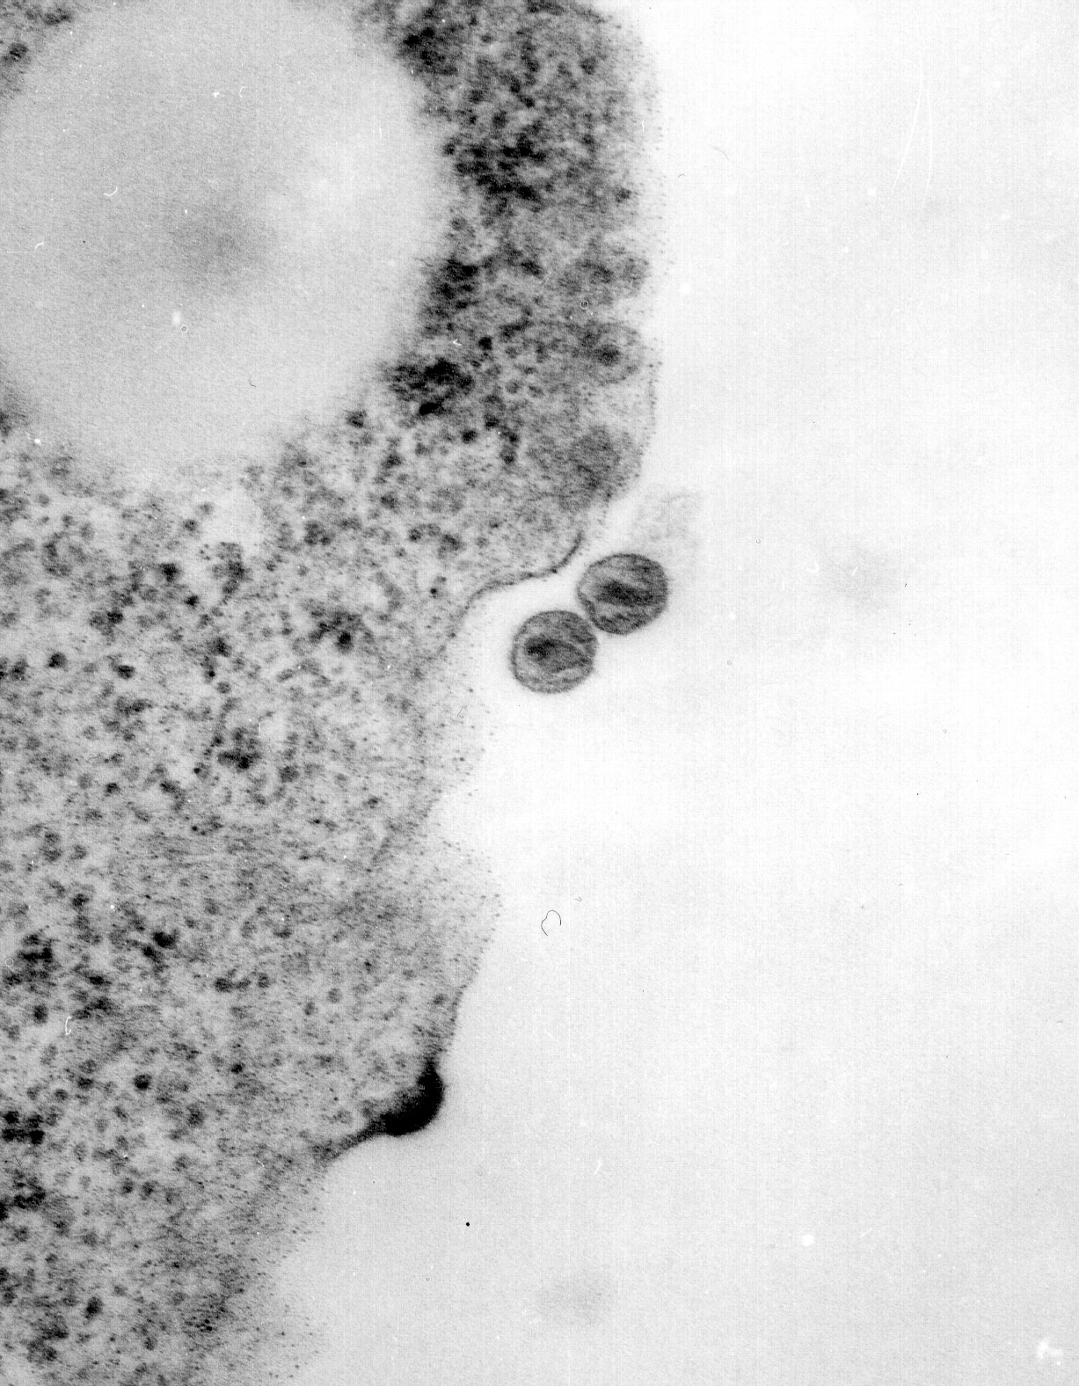
Notes:
Im going to talk about studies using SIVmac239 as a model system for understanding neutralization resistance.

Slide 13
Families of Viruses
DNA RNA RNA
Adenoviruses Reoviruses Retroviruses (env)
Papovaviruses Picornaviruses Bunyaviruses (env)
Papillomaviruses Arenaviruses (env) Filoviruses (env)
Parvoviruses Togaviruses (env) Coronaviruses (env)
Herpesviruses (env) Calciviruses Astroviruses
Poxviruses Flaviviruses (env) Bornaviruses (env)
Hepadnaviruses (env) Orthomyxo (env) Rhabdoviruses (env)
Paramyxo (env)

Slide 14
Acute vs Persisting Viruses
Acute
  Most viruses are in this category
  Replicate as much as they can as fast as they can
  Outcomes: clearance by the immune system or death
  Their survival depends on the ability to spread from one individual to another prior to immune clearance
Persistent
  Six of the virus families are classically persistent
  They have evolved strategies to persist for the life of the infected individual
  Some are oncogenic (cause cancer)

Slide 15
An astounding fact:
22% of cancers worldwide have a viral etiology
Persisting viruses often use a strategy of cell growth immortalization, cell growth transformation, to achieve life-long persistence
Viral-induced cell-growth transformation is an initiating event; further mutations in the cellular genome can lead to a full-blown, growth-transformed cancer cell

Slide 17
What are they ?
Cervical carcinoma - papillomavirus - HPV 16&18
Adult T cell leukemia – retrovirus - HTLV
Burkitt’s Lymphoma - herpesvirus - EBV
Nasopharyngeal carcinoma –herpes - EBV
Hepatocellular carcinoma -hepadna -HBV and HCV
Kaposi’s sarcoma - herpesvirus -HHV-8 (KSHV)
Pleural effusion lymphoma -herpes -HHV-8 (KSHV)

Slide 18
The Herpesvirus Family
Double-stranded DNA genome
Genetically complex: 130,000 – 180,000 base pairs of DNA, enough to encode 80 – 120 proteins
Enveloped
Persistent - once infected you are infected for life

Slide 20
Herpesvirus Family
Alpha
herpes simplex virus (HSV 1 and 2)
varicella zoster virus (VZV)
Beta
cytomegalovirus (CMV)
HHV-6
HHV-7
Gamma-1
Epstein Barr virus (EBV)
Gamma-2
KSHV (HHV-8)

Slide 21
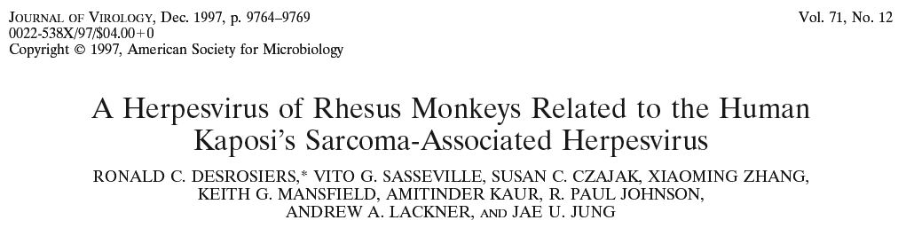

Slide 22
Herpesvirus lytic life cycle

Slide 23
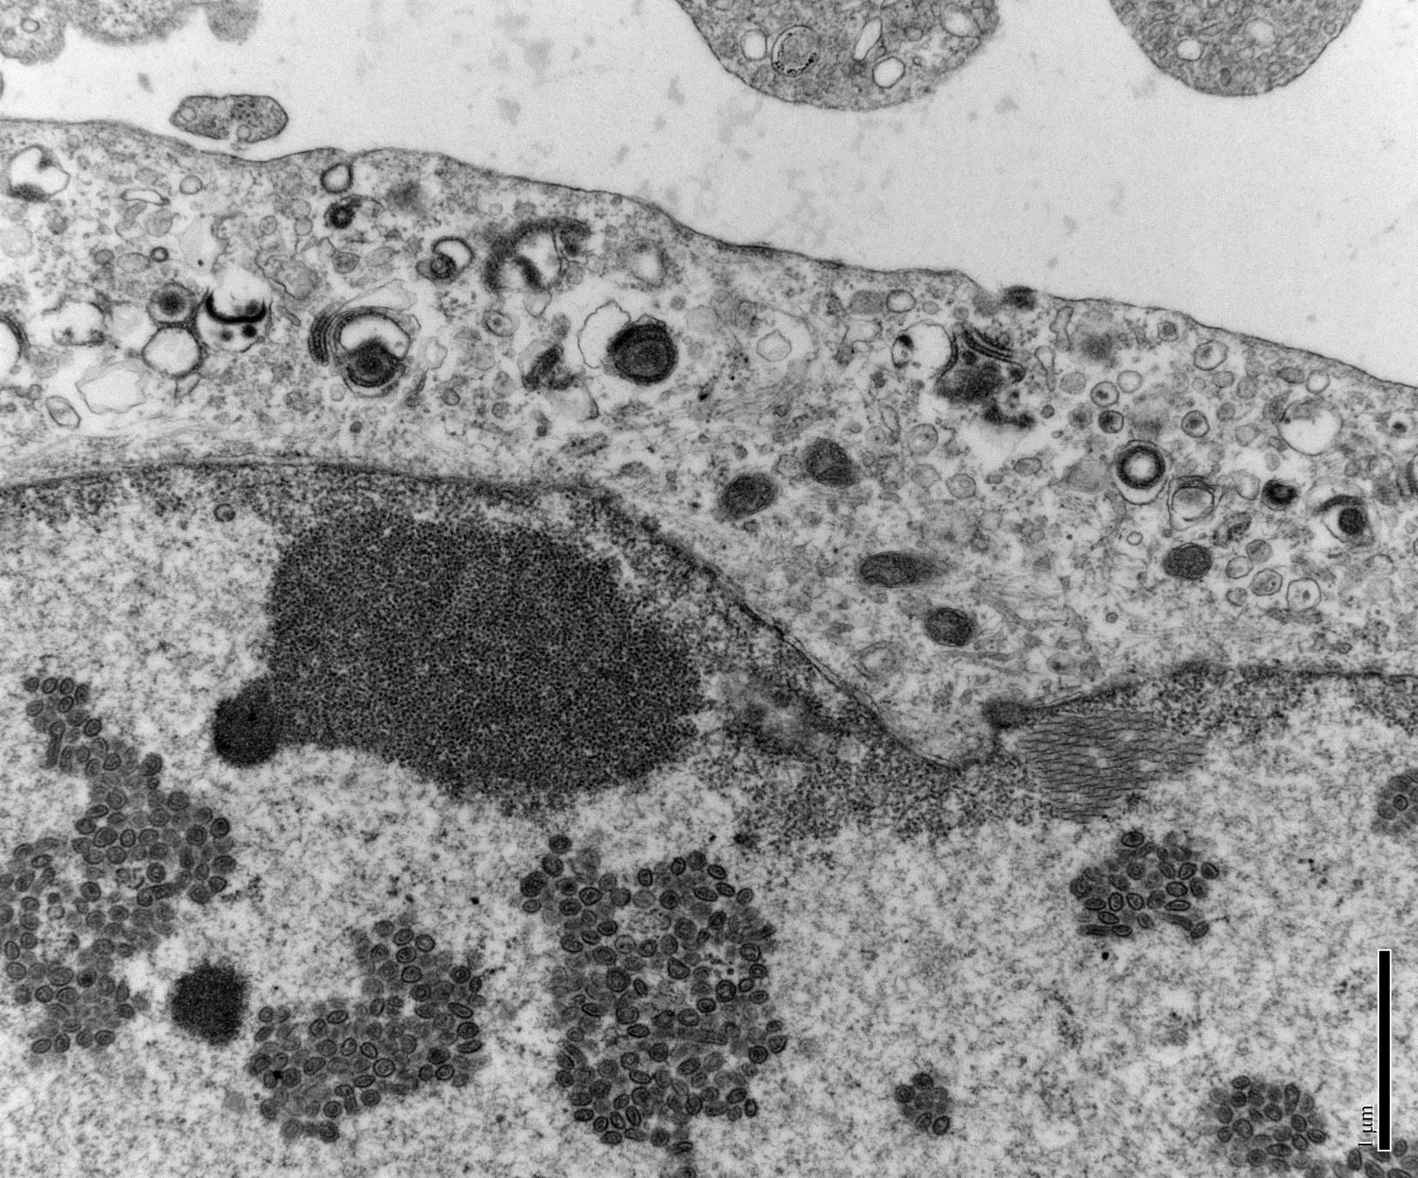
rRRV-SIvnf7-day5
Immature viral particles
Immature rRRV

Slide 24
The Retrovirus Family
Single-stranded (+) RNA genome
7-10 kilobases of genetic information
As few as 3, as many as 9, viral-encoded proteins
Enveloped
persistent

Slide 25
Notes:
Im going to talk about studies using SIVmac239 as a model system for understanding neutralization resistance.

Slide 28
Two human retroviruses
Human T-cell Leukemia Virus - HTLV
discovered in 1979-80 Poiesz et al (Gallo)
a delta retrovirus
Human immunodeficiency virus - HIV
discovered in 1983-84 Barre-Sinoussi and Montagnier (Gallo)
a lentivrus

Slide 32
HIV Replication is Persistent and Unrelenting
10⁷
HIV virions
per ml
plasma
10⁵
no Haart
10⁴
with Haart
10²
2
20
200
Weeks post infection

Slide 33
Arms of the Immune System
Innate Immunity
restriction factors
interferon
Humoral Immunity (antibodies)
virus neutralizing activity
antibody dependent cellular cytotoxicity (ADCC)
Cellular Immunity
cytotoxic T cells

Slide 34
Persistent Replication: What’s Wrong with the Immune Response?
HIV counteracts innate immunity
HIV resists neutralization by antibodies.
  inherent resistance
  escape
  lack of CD4 cell help
HIV resists control by CD8+ cytotoxic T lymphocytes.
  escape
  lack of CD4 help
  nef downregulates MHC class I

Slide 35
HIV counteracts innate immunity
Cellular restriction factor
is counteracted by viral gene
APOBEC3g
Tetherin
TRIM5
SamHD1
Vif
Vpu and/or nef
Gag
vpx

Slide 36
Persistent Replication: What’s Wrong with the Immune Response?
HIV resists neutralization by antibodies
  inherent resistance
  escape
  lack of CD4 cell help

Slide 37
Persistent Replication: What’s Wrong with the Immune Response?
HIV resists neutralization by antibodies
  inherent resistance
    neut ab titers are low and strain specific
    compact, trimeric structure
    heavily glycosylated (>50% of mass)
    stepwise 2-receptor entry mechanism
    only a few potent, broadly neutralizng ab
    largely inaccessible to antibodies

Slide 38
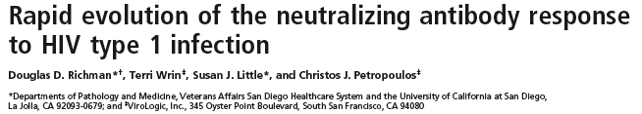
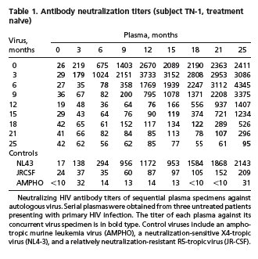

Slide 39
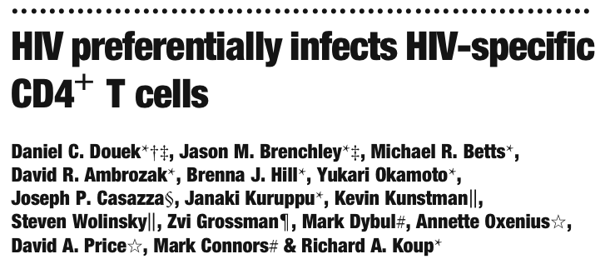
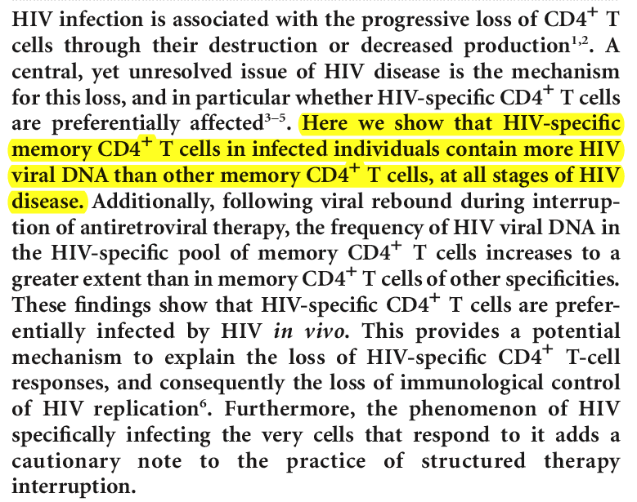

Slide 40
Persistent Replication: What’s Wrong with the Immune Response?
HIV resists control by CD8+ cytotoxic T lymphocytes.
  escape
  lack of CD4 help
  nef downregulates MHC class I

Slide 41
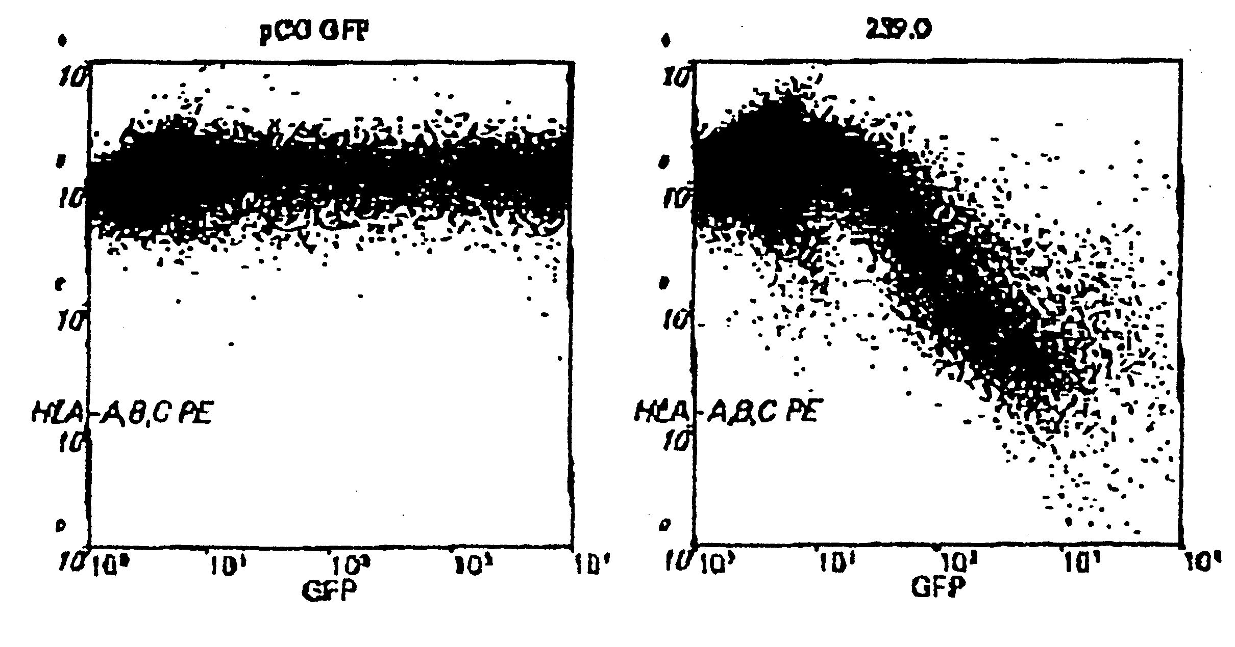
DOWNREGULATION OF MHC BY SIV239 NEF
MHC

Slide 42
Some of the lessons from today
22 families of viruses
6 of these 22 are classically persisting viruses
HIV is a member of the lentivirus subfamily of retroviruses
ssRNA(+), 9 genes, enveloped
Continuous unrelenting HIV replication in the face of apparently strong host immune responses
HIV uses a variety of immune evasion strategies to achieve this persistent unrelenting viral replication

Slide 43
HIV Replication is Persistent and Unrelenting
10⁷
HIV virions
per ml
plasma
10⁵
no Haart
10⁴
with Haart
10²
2
20
200
Weeks post infection

Slide 44
Persistent Replication: What’s Wrong with the Immune Response?
HIV counteracts innate immunity
HIV resists neutralization by antibodies.
  inherent resistance
  escape
  lack of CD4 cell help
HIV resists control by CD8+ cytotoxic T lymphocytes.
  escape
  lack of CD4 help
  nef downregulates MHC class I

